Slide 1
Software Development
From Idea to Successful Software Product
BY ELYSIUM ACADEMY

Slide 2
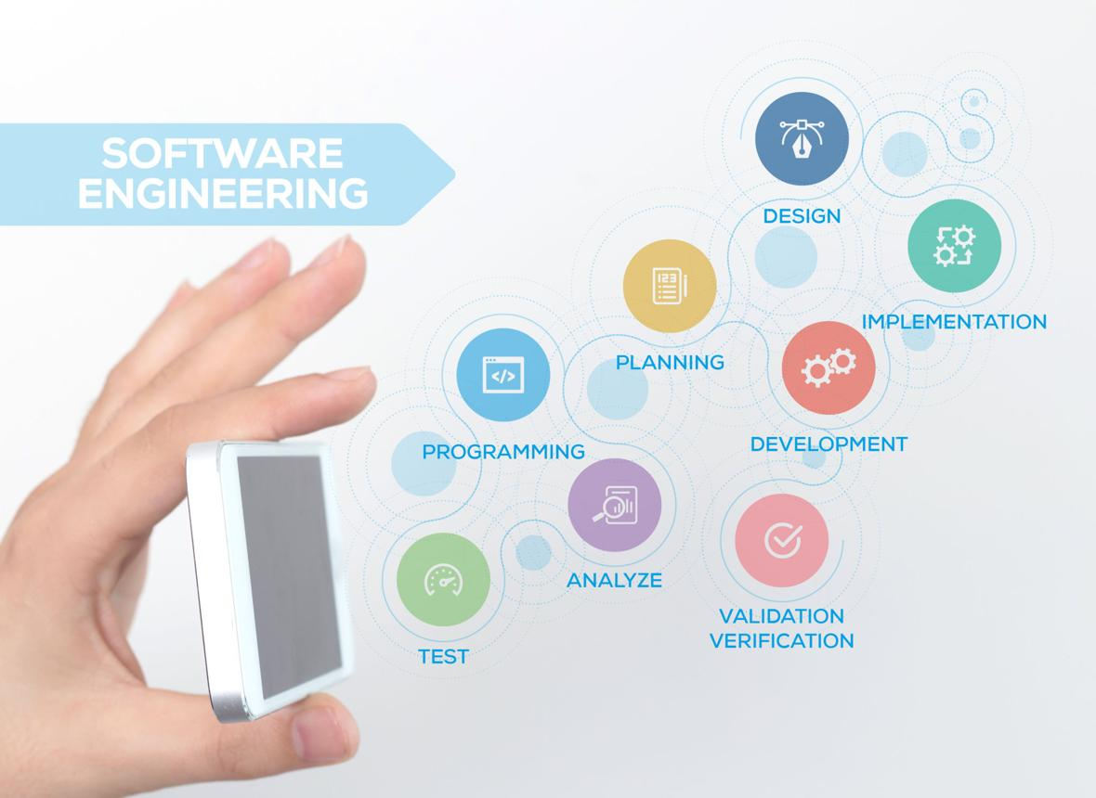
Topics Covered
Introduction
Software Development Life Cycle (SDLC)
Development Methodologies
Roles and Responsibilities
Challenges and Best Practices
What is Software Development ?
Definition
Software Development is the process of designing, creating, testing, deploying, and maintaining software applications to solve specific problems or meet business needs.

Slide 3

What is Software Development Cont..
Objectives
Automate tasks
Improve efficiency
Solve business problems
Enhance user experience
Support digital transformation
Examples
Mobile Apps
Websites
Banking Systems
E-commerce Platforms
Enterprise Software

Slide 4

Importance of Software Development
Why is it Important?
Powers modern businesses
Enables digital communication
Supports automation
Improves productivity
Facilitates innovation
Creates new business opportunities
Real-World Applications
Healthcare
Education
Finance
Transportation
Entertainment

Slide 5
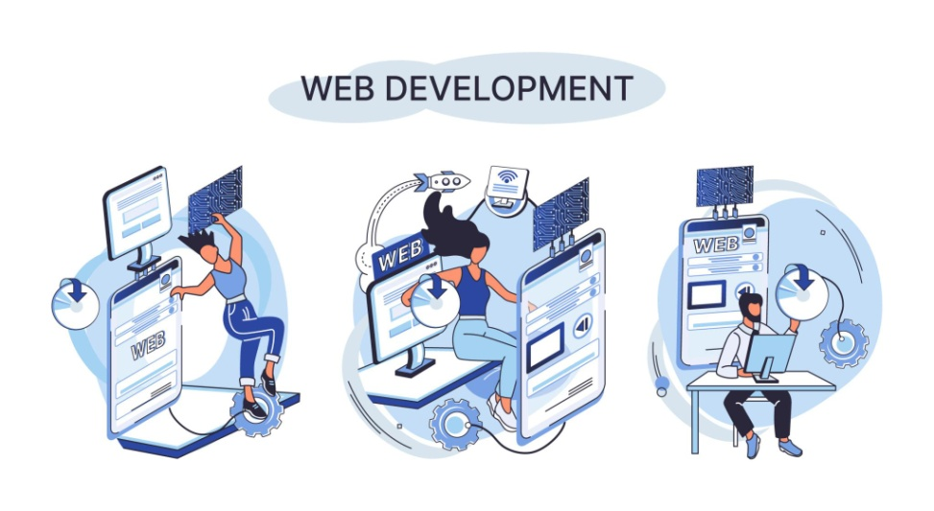
Types of Software Development
Major Categories
1. Application Development
Software for end users.
2. Web Development
Websites and web applications.
3. Mobile Development
Android and iOS applications.
4. System Development
Operating systems and utilities.
5. Cloud Development
Cloud-based software solutions.

Slide 6
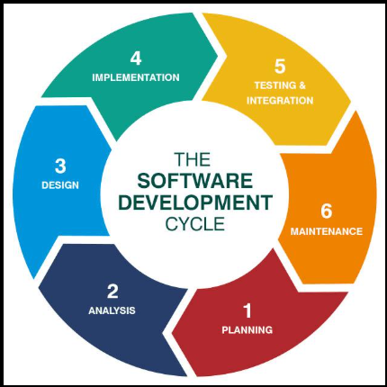
Software Development Life Cycle (SDLC)
What is SDLC?
A structured framework used to develop software efficiently while maintaining quality and reducing risks.
Main Phases
Requirement Gathering
Planning
Design
Development
Testing
Deployment
Maintenance

Slide 7

Requirement Gathering
Purpose
Understand what the customer or users need.
Activities
Client meetings
Interviews
Surveys
Requirement analysis
Documentation
Deliverables
Functional Requirements
Non-Functional Requirements
Requirement Specifications

Slide 8
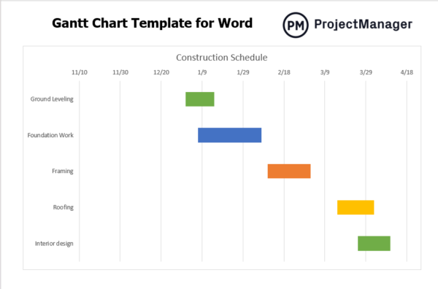
Planning and Feasibility Study
Objectives
Evaluate:
Technical feasibility
Financial feasibility
Operational feasibility
Resource availability
Project timeline
Outputs
Project Plan
Budget Estimation
Risk Assessment

Slide 9
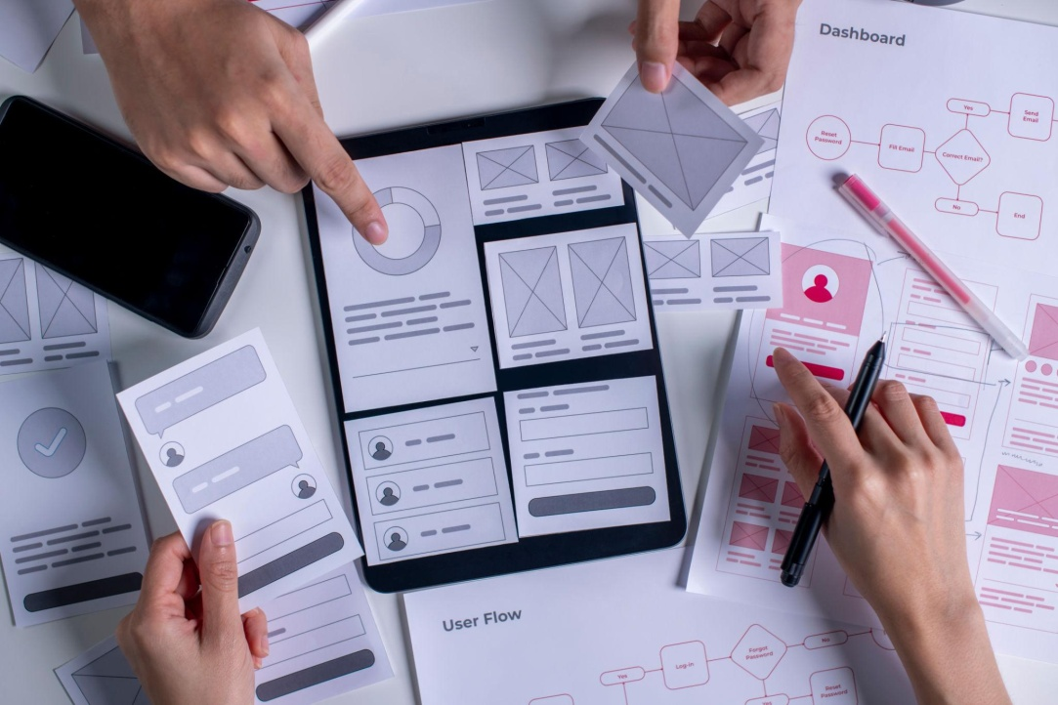
Software Design
Purpose
Create the blueprint of the software system.
Design Components
System Architecture
Database Design
User Interface Design
Security Design
Module Design
Benefits
Better organization
Easier development
Reduced future issues

Slide 10

Development ( Coding )
Implementation Phase
Developers convert designs into actual software.
Activities
Writing code
Version control
Code reviews
Integration of modules
Popular Languages
Java
Python
C#
JavaScript
C++

Slide 11
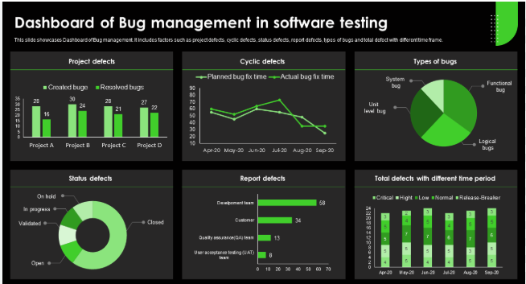
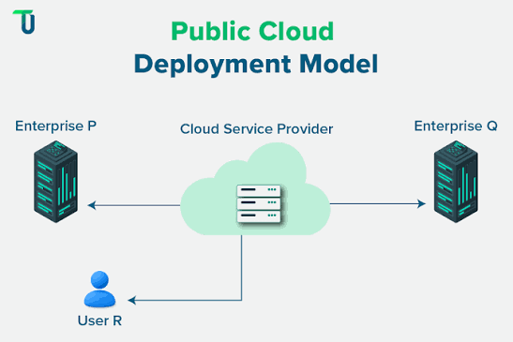
Software Testing
Purpose
Ensure software quality and reliability.
Types of Testing
Unit Testing
Integration Testing
System Testing
Performance Testing
User Acceptance Testing
Benefits
Detect defects early
Improve quality
Increase user satisfaction
Deployment
What Happens Here?
The completed software is released to users.
Activities
Installation
Configuration
Data Migration
Production Release
Benefits
Product availability
Customer access
Business value generation

Slide 12
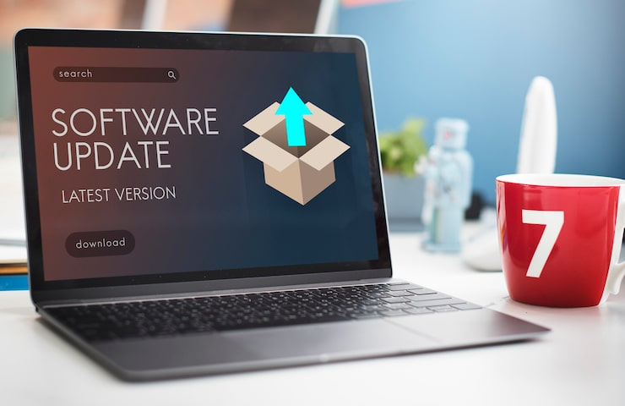
Maintenance
Post-Release Activities
Software must continue to evolve.
Types of Maintenance
Corrective
Adaptive
Perfective
Preventive
Examples
Bug fixes
Security updates
Feature enhancements
Performance improvements

Slide 13
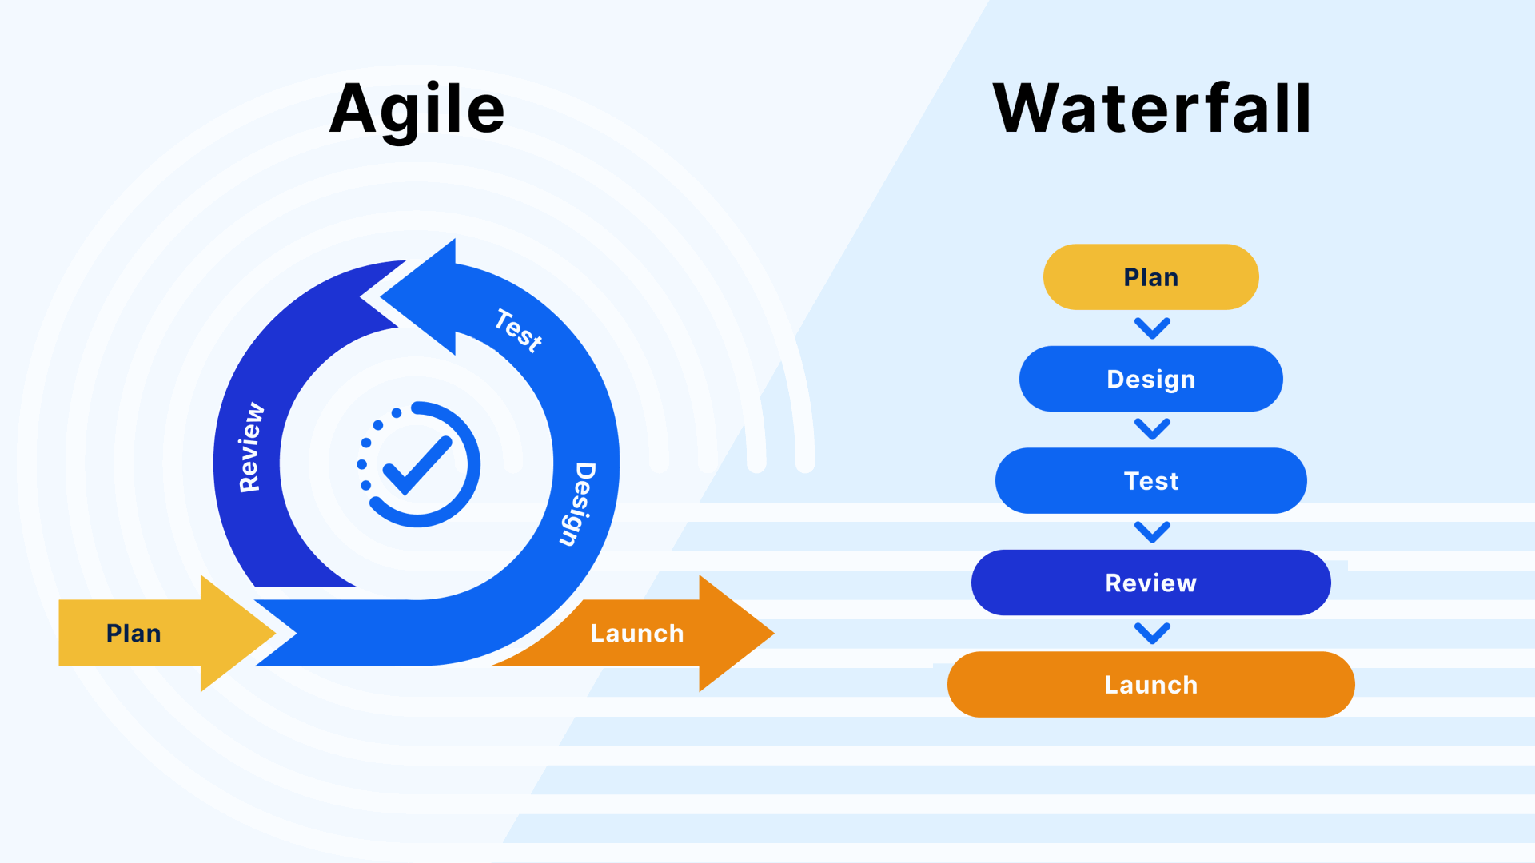
Software Development Methodologies
Common Approaches
Waterfall Model
Sequential process.
Agile Model
Iterative and flexible development.
Scrum
Sprint-based development.
DevOps
Development and operations collaboration.
Why Agile is Popular
Faster delivery
Continuous feedback
Better adaptability

Slide 14
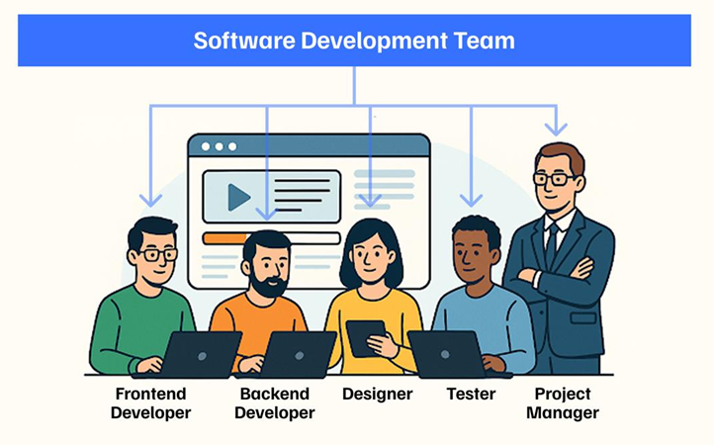
Roles in Software Development
Key Team Members
Business Analyst
Collects requirements.
Project Manager
Manages project execution.
Software Developer
Builds the software.
UI/UX Designer
Designs interfaces.
Tester / QA Engineer
Ensures quality.
DevOps Engineer
Handles deployment and operations.

Slide 15

Challenges and Best Practices
Common Challenges
Changing requirements
Tight deadlines
Budget constraints
Security concerns
Software defects
Best Practices
✅ Clear requirements
✅ Proper planning
✅ Version control
✅ Regular testing
✅ Documentation
✅ Continuous improvement
Key Takeaway
"Successful software development combines planning, teamwork, quality assurance, and continuous improvement to deliver valuable solutions."

Slide 16
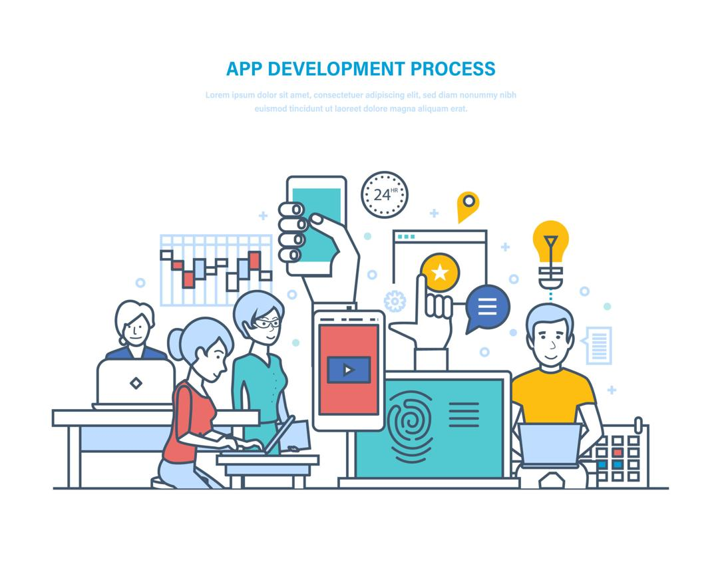
Transforming Ideas into Software Solutions
Topics Covered
Introduction to Software Development
Software Development Life Cycle (SDLC)
Development Models
Team Roles
Best Practices

Slide 17
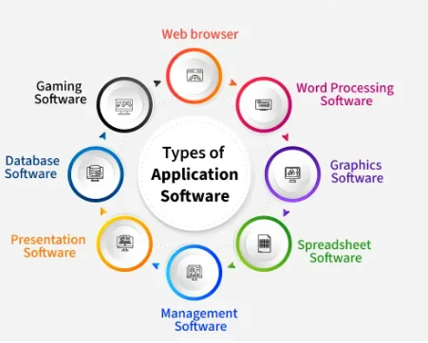
Introduction to Software Development
What is Software Development?
Software Development is a structured process of designing, building, testing, deploying, and maintaining software applications to solve business and user problems.
Examples
Mobile Applications
Websites
Enterprise Systems
Banking Software
E-Commerce Platforms
Benefits
Automation
Efficiency
Accuracy
Innovation

Slide 18

Importance of Software Development
Why is Software Development Important?
Supports business growth
Improves productivity
Enables digital services
Facilitates communication
Drives technological innovation
Industries Using Software
Healthcare
Education
Banking
Manufacturing
Transportation

Slide 19
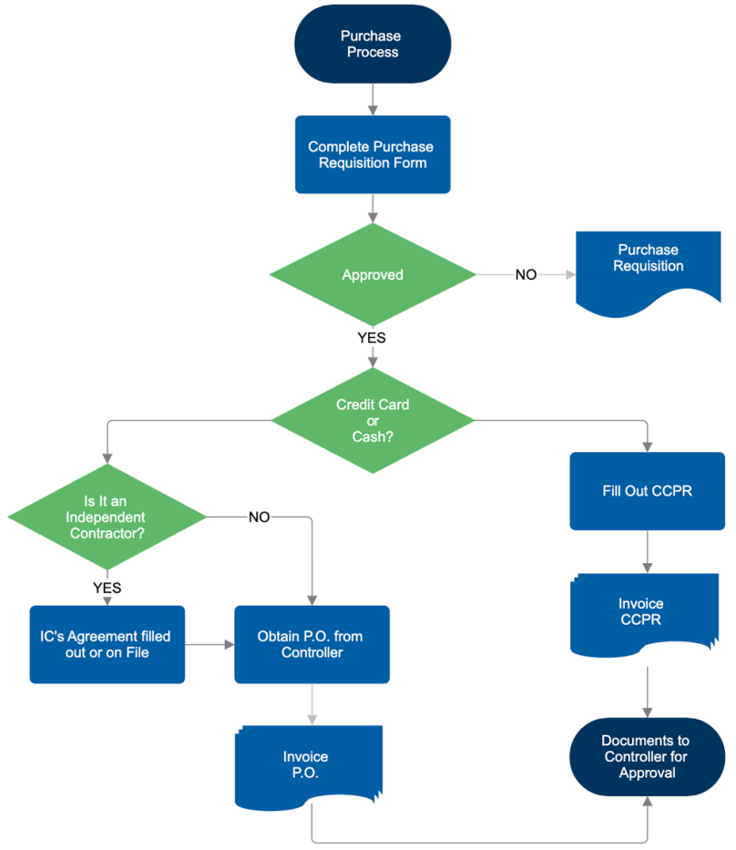
Software Development Process
Main Activities
Communication
Requirement Gathering
Feasibility Study
System Analysis
Design
Coding
Testing
Integration
Deployment
Maintenance
These activities help ensure the software meets user requirements and quality standards.

Slide 20
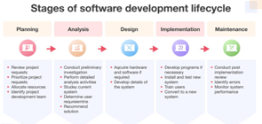
Software Development Life Cycle (SDLC)
What is SDLC?
SDLC is a structured framework that guides software development from concept to retirement. It helps teams deliver software efficiently while controlling cost, quality, and risks.
Objectives
Improve quality
Reduce risks
Meet deadlines
Enhance customer satisfaction

Slide 21

Requirement Gathering
Purpose
Understand customer and stakeholder needs.
Techniques
Interviews
Surveys
Questionnaires
Existing system analysis
Stakeholder discussions
Deliverables
User Requirements
Functional Requirements
System Requirements

Slide 22
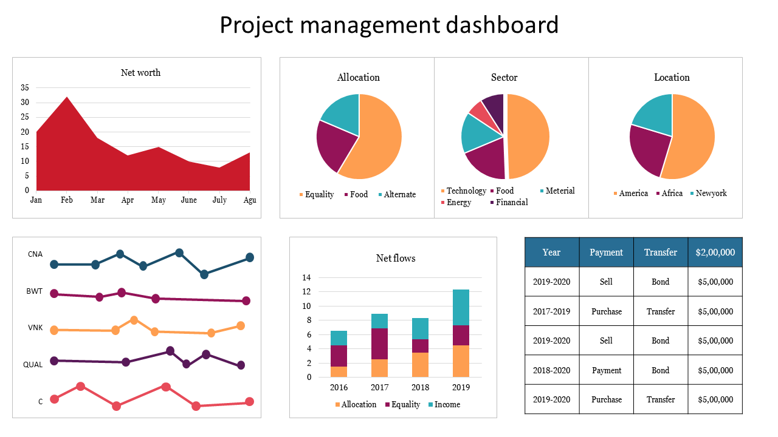
Feasibility Study and Planning
Objective
Determine whether the project is practical and achievable.
Types of Feasibility
Technical Feasibility
Economic Feasibility
Operational Feasibility
Schedule Feasibility
Outcomes
Project Plan
Cost Estimation
Risk Assessment

Slide 23
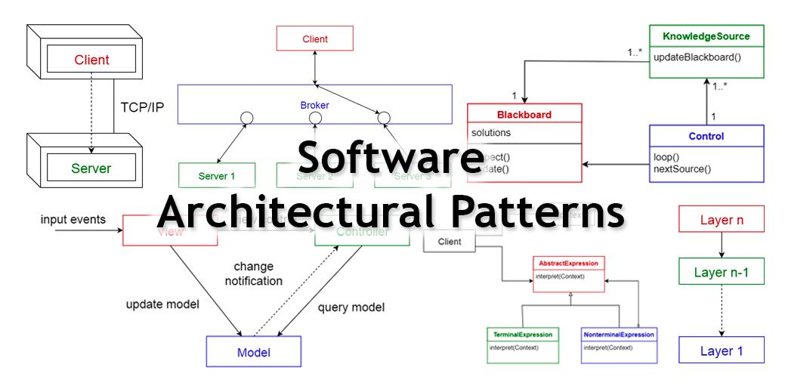

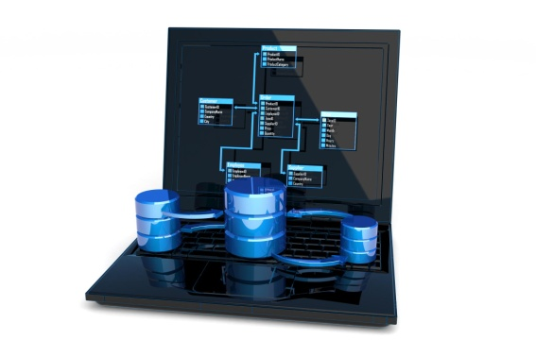
System Analysis and Design
System Analysis
Understand business needs
Identify limitations
Define project scope
System Design
Database Design
User Interface Design
Architecture Design
Security Design
Outputs
Logical Design
Physical Design
Design Documents

Slide 24
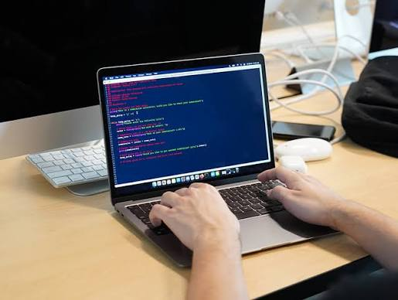
Coding and Development
Development Phase
Developers convert designs into executable software.
Activities
Programming
Code Reviews
Version Control
Module Development
Popular Languages
Java
Python
JavaScript
C#
C++

Slide 25
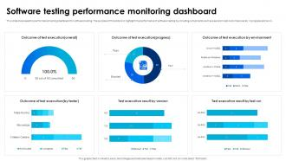
Testing and Quality Assurance
Purpose
Ensure software works correctly and meets requirements.
Types of Testing
Unit Testing
Integration Testing
System Testing
Acceptance Testing
Performance Testing
Benefits
Error Detection
Improved Reliability
Better User Experience

Slide 26
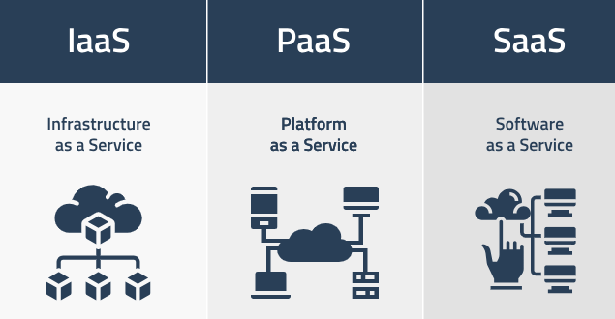
Integration and Deployment
Integration
Combining software modules and external systems.
Deployment
Installing and releasing software to users.
Activities
Configuration
Installation
Data Migration
Environment Setup

Slide 27
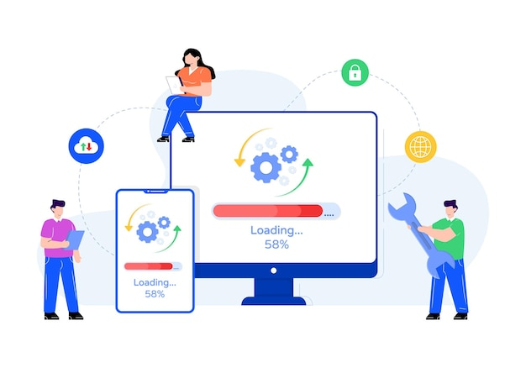
Maintenance
Post-Deployment Activities
Software requires continuous updates and improvements.
Types of Maintenance
Corrective Maintenance
Adaptive Maintenance
Perfective Maintenance
Preventive Maintenance
Examples
Bug Fixes
Security Updates
Feature Enhancements

Slide 28
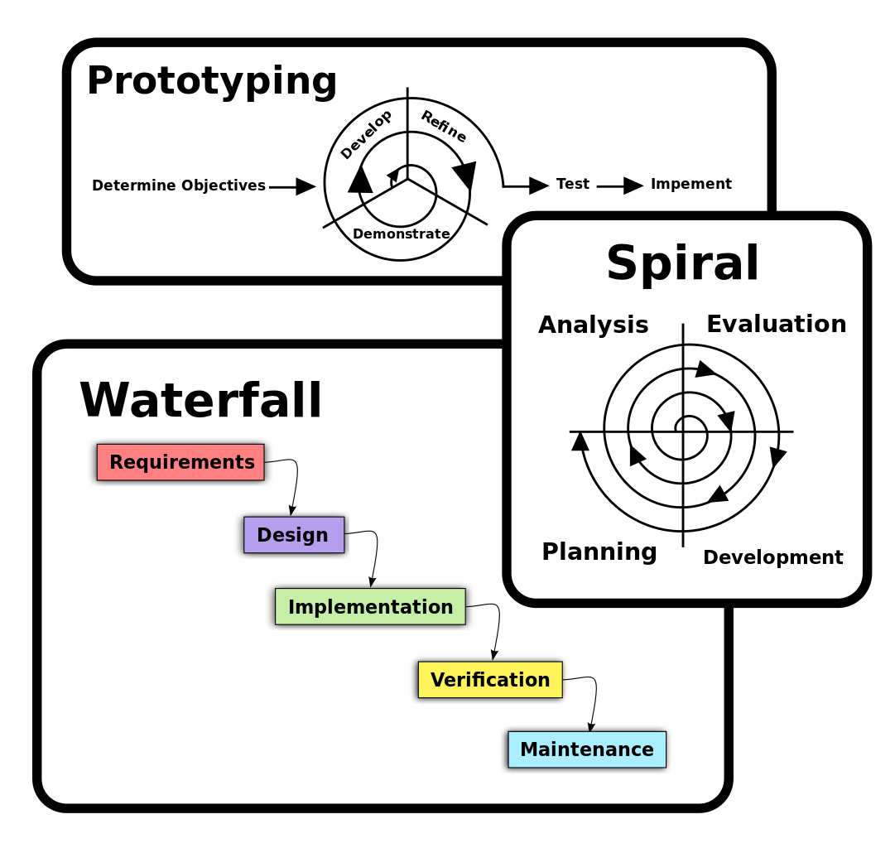
Software Development Models
Common SDLC Models
Waterfall Model
Sequential development process.
Iterative Model
Development through repeated cycles.
Spiral Model
Risk-focused iterative approach.
V-Model
Verification and validation at every stage.
Big Bang Model
Minimal planning and rapid experimentation.

Slide 29
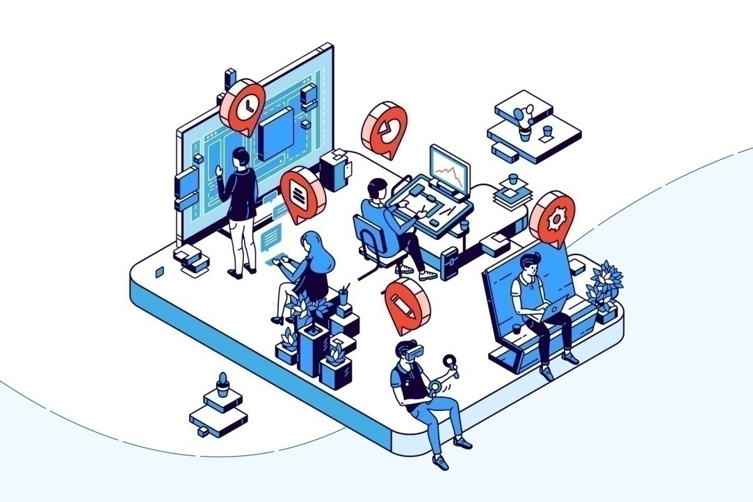
Roles in Software Development
Key Team Members
Business Analyst
Collects and analyzes requirements.
Project Manager
Plans and manages projects.
Software Developer
Builds software applications.
UI/UX Designer
Designs user interfaces.
QA Engineer
Tests software quality.
DevOps Engineer
Handles deployment and operations.

Slide 30

Challenges and Best Practices
Common Challenges
Changing requirements
Budget limitations
Security concerns
Tight schedules
Software defects
Best Practices
✔ Clear Requirements
✔ Proper Documentation
✔ Continuous Testing
✔ Version Control
✔ Team Collaboration
✔ Regular Maintenance
Conclusion
Successful software development requires planning, communication, quality assurance, teamwork, and continuous improvement.

Slide 31
REFERENCES
https://www.google.com/search?q=Software+Development+Tutorial&rlz=1C1CHBD_enIN1039IN1039&oq=Software+Development+Tutorial&gs_lcrp=EgZjaHJvbWUqBggAEEUYOzIGCAAQRRg7MgcIARAAGIAEMggIAhAAGBYYHjIICAMQABgWGB4yCAgEEAAYFhgeMggIBRAAGBYYHjIICAYQABgWGB4yCAgHEAAYFhgeMggICBAAGBYYHjIICAkQABgWGB7SAQoxOTk5N2owajE1qAIAsAIA&sourceid=chrome&ie=UTF-8
notes Notes NOTES ( Notes 1 To Notes 6 ) : https://github.com/Narthana-Elysium

